Slide 1


CONFIGURABLE SET ASSOCIATIVE CACHE
PRESENTED BY:
Ammarah Wakeel 2023_EE_54
Ayesha Anwar 2023_EE_55

Slide 2
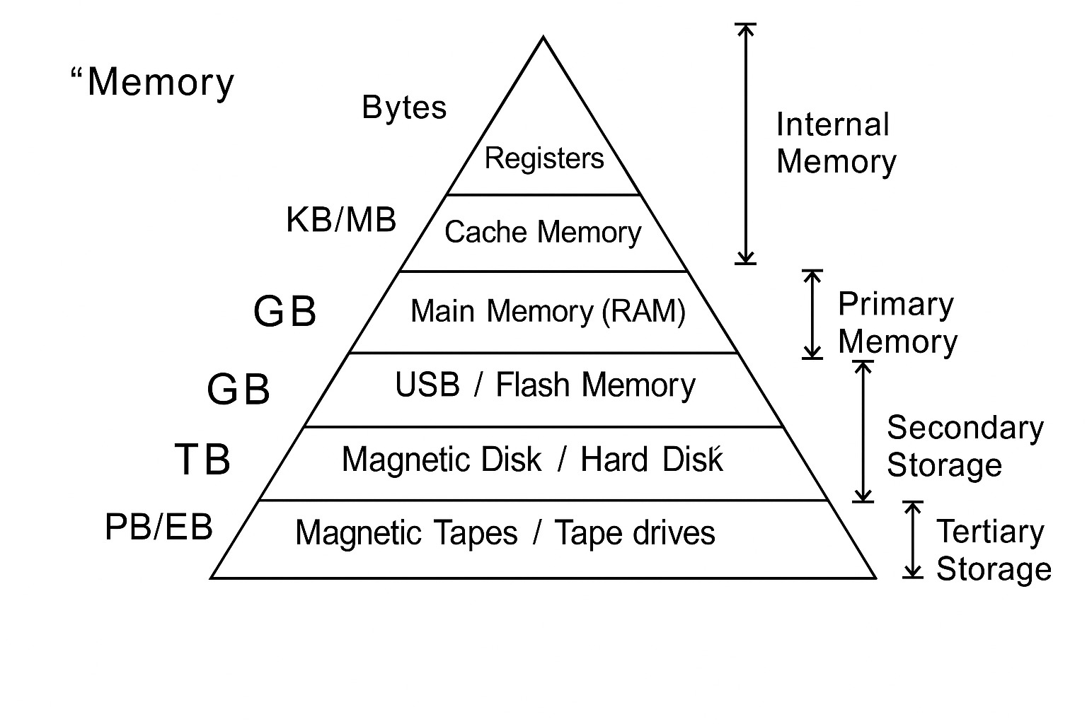
MEMORY HIERARCHY
If all kinds of memory stores data, why do computers need so many different types?

Slide 3
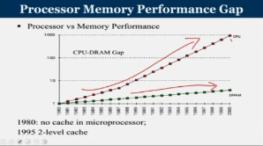

Slide 4

WHAT IS CACHE MEMORY?
A cache is a small, fast memory located close to the CPU that stores frequently accessed data or instructions to speed up future access.
Small and fast buffer between processor and main memory.

Slide 5
Block / Line
Hit
CACHE
FUNDAMENTALS
Miss
Hit Time
Hit rate / Miss Rate
Miss Penalty

Slide 6
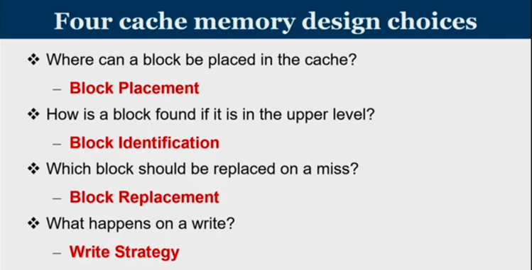

Slide 7
BLOCK PLACEMENT
DIRECT MAPPING
FULLY ASSOCIATIVE MAPPING
SET- ASSOCIATIVE MAPPING

Slide 8
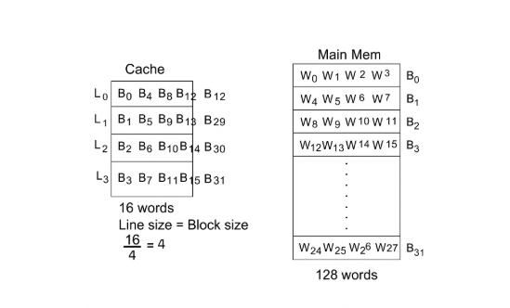
DIRECT MAPPING
No. of blocks = 128/4 =32 = 2^5
Cache line/block size = Block size of main memory.
How is a physical address divided to locate data in main memory and cache?

Slide 9
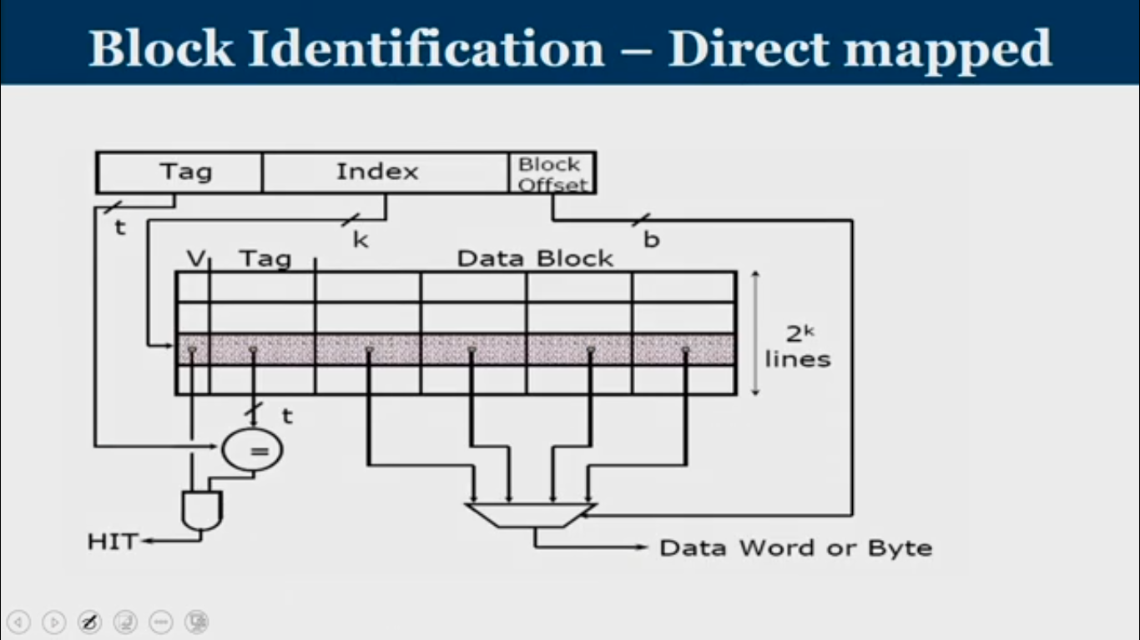

Slide 10
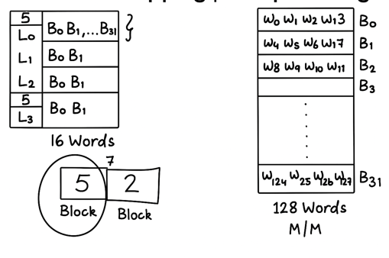
FULLY ASSOCIATIVE MAPPING

Slide 11
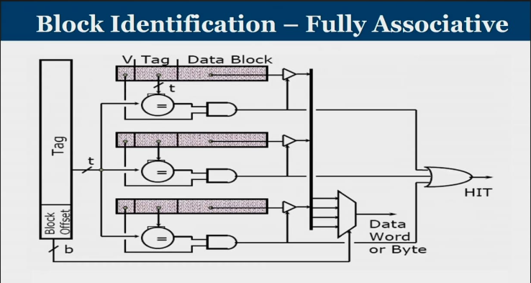

Slide 12
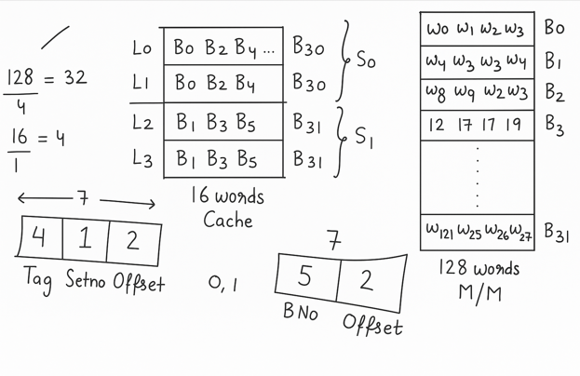
SET_ASSOCIATIVE MAPING

Slide 13
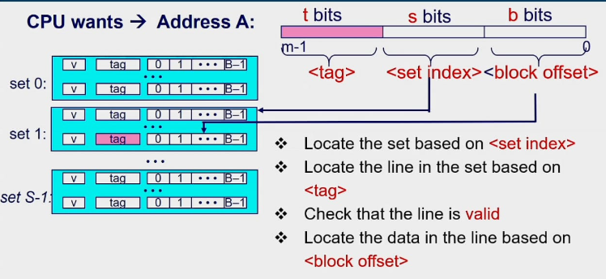
ADDRESSING CACHES

Slide 14
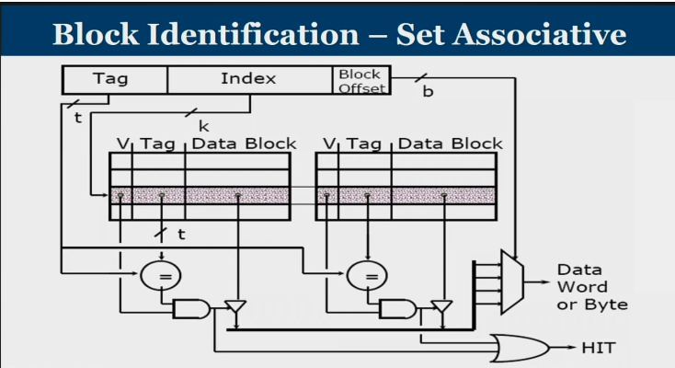

Slide 15
TYPES OF MISSES :
Conflict misses
Compulsary misses
Capacity miss

Slide 16
LOCALITY OF REFERNCE
Programs access relatively small portion of their address space at any instant of time
Temporal Locality
Spatial Locality
If a memory location is accessed, it is likely to be accessed again in the near future
Formula: If a location L is accessed at time T, then: 𝑃(access L at 𝑇+Δ𝑇) is high
If a memory location is accessed, nearby memory locations are likely to be accessed soon.
Formula: If a location L is accessed at time T , then:
𝑃(access L + Δ𝐿 at 𝑇+Δ𝑇) is high

Slide 17
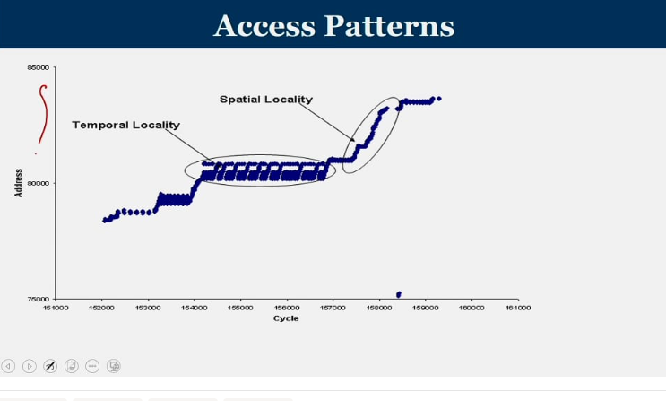

Slide 18
BLOCK REPLACEMENT
Cache has finite size. What do we do when it gets filled ? Which block to be replaced for a set associative cache?

Slide 19
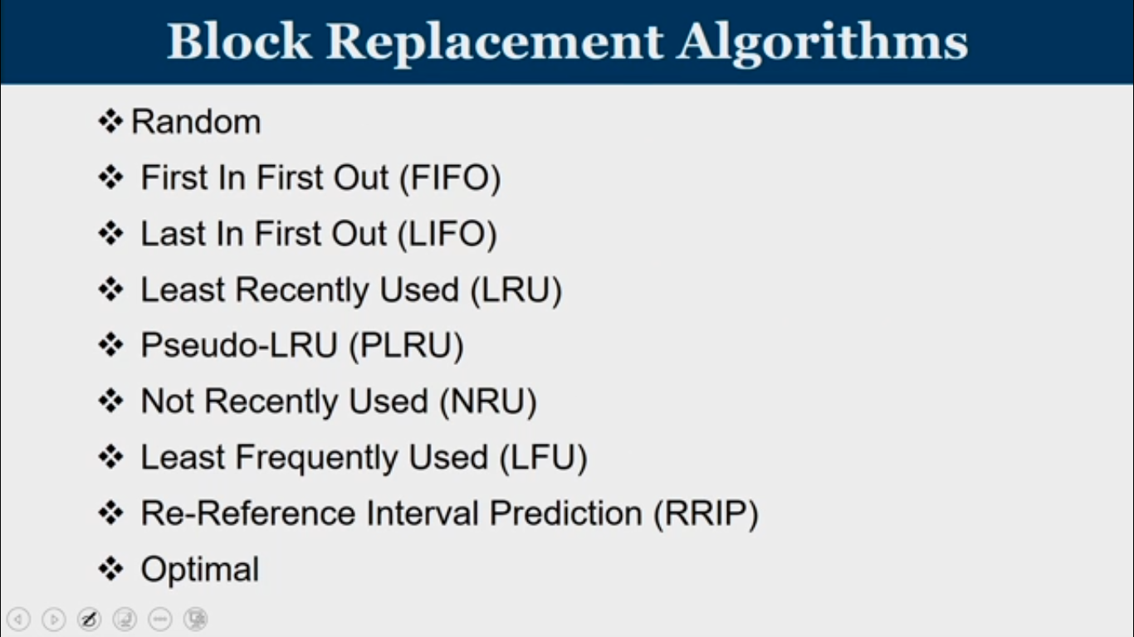

Slide 20
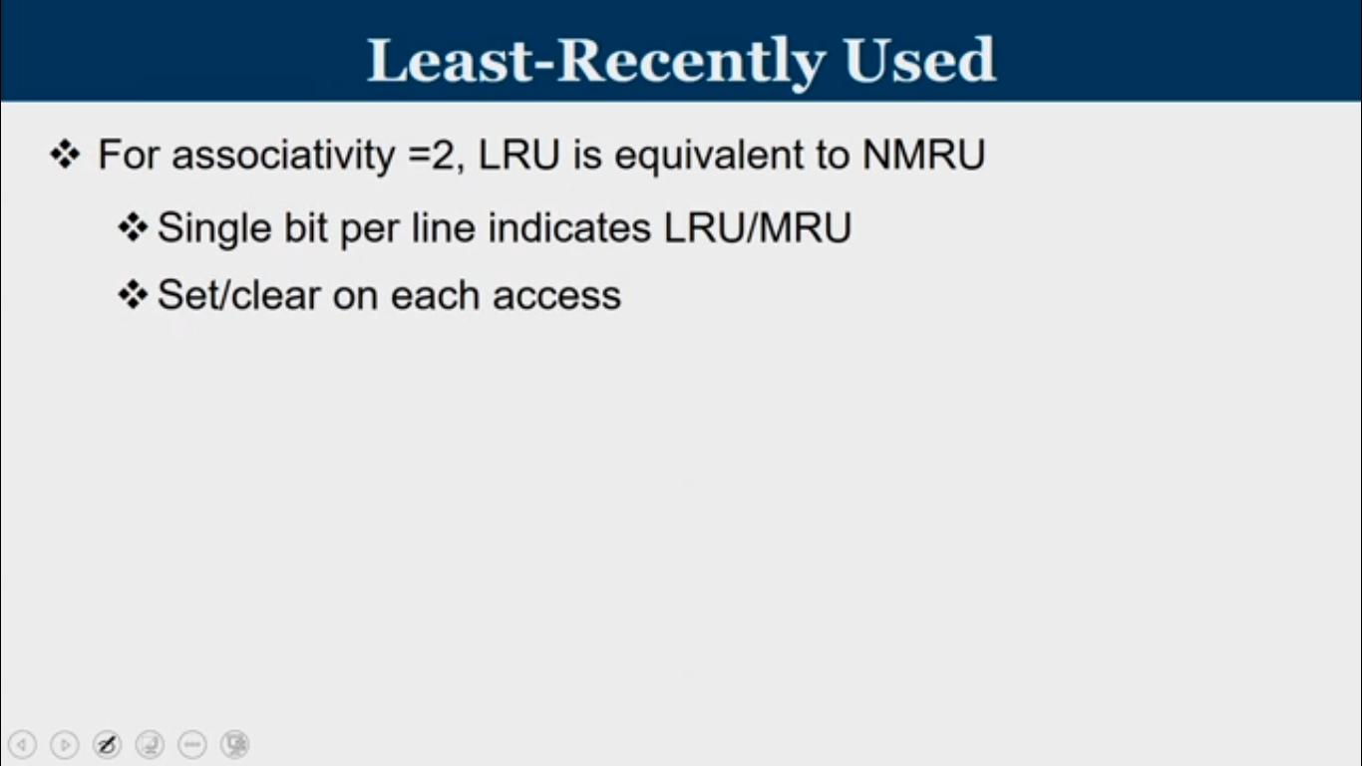
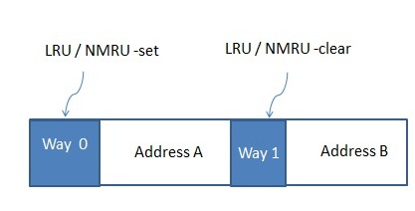

Slide 21
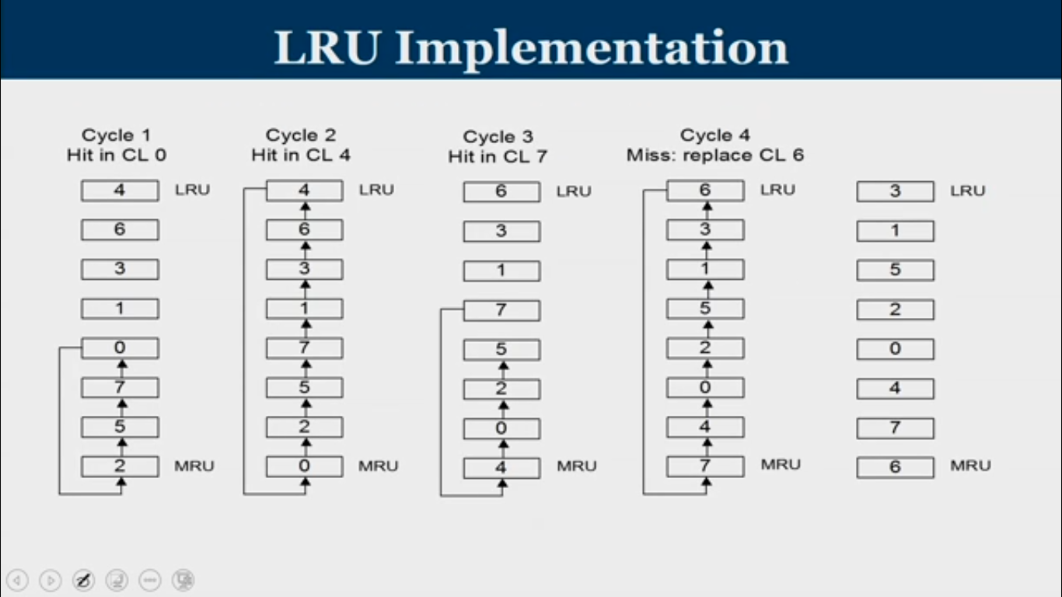
REQUIRED DATA

Slide 22
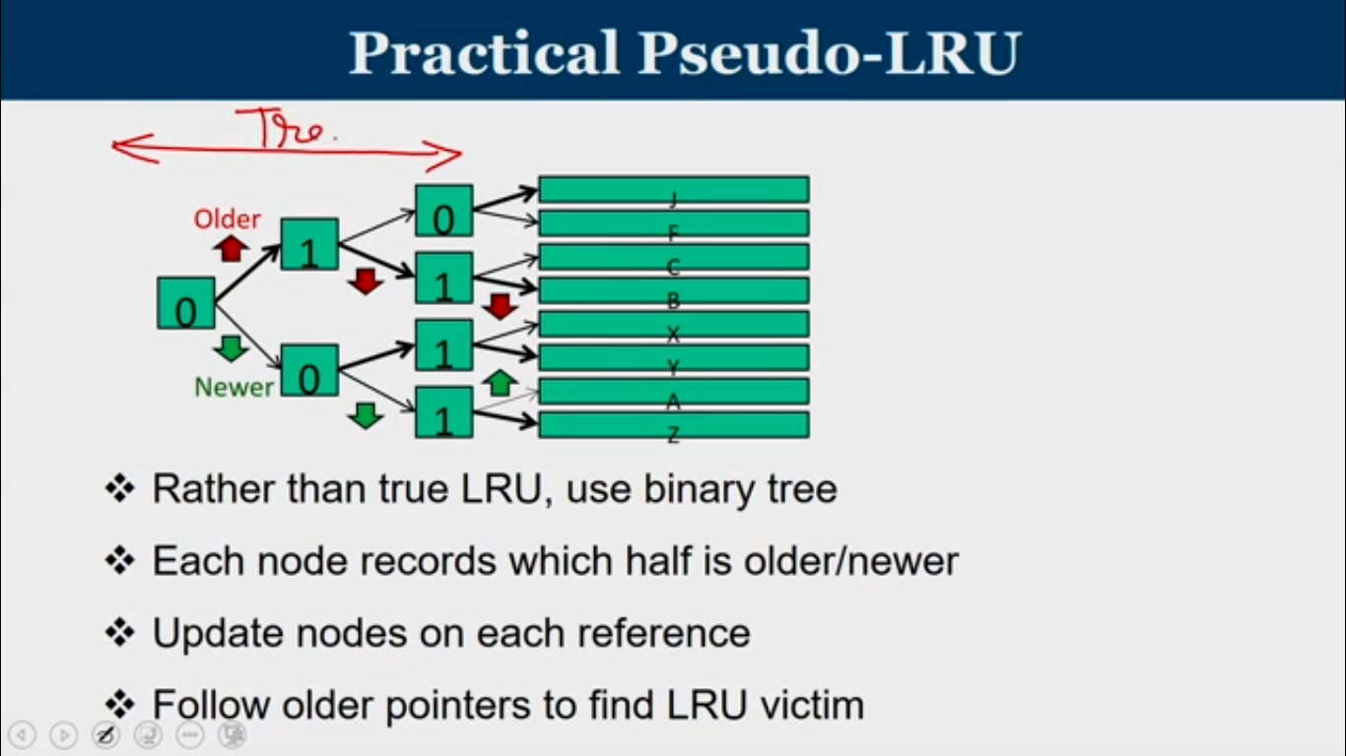

Slide 23
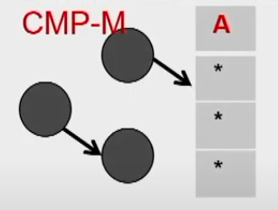
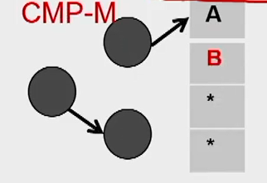
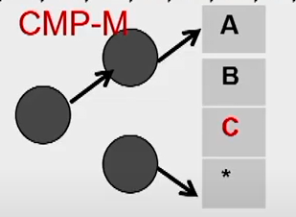
consider the following 14 block numbers that are mounted to a particular set n given in the order of arrival;

Slide 24
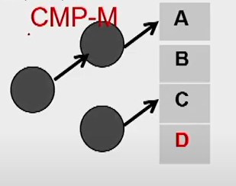
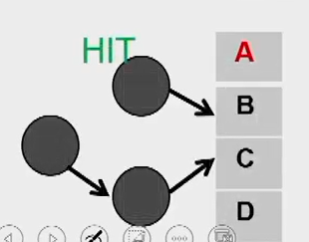
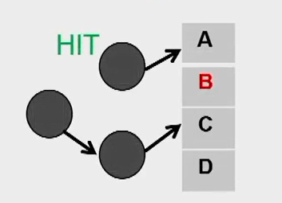
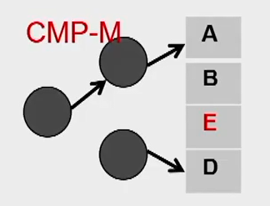
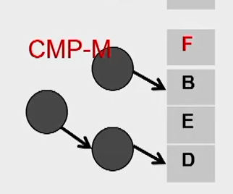
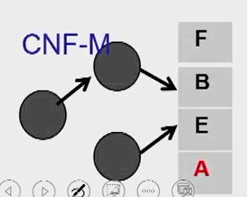

Slide 25
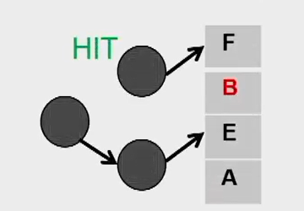
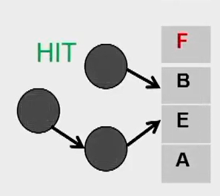
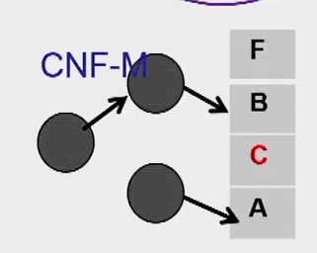
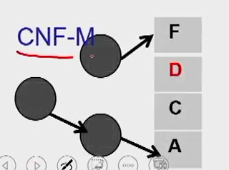
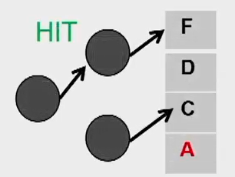

Slide 26
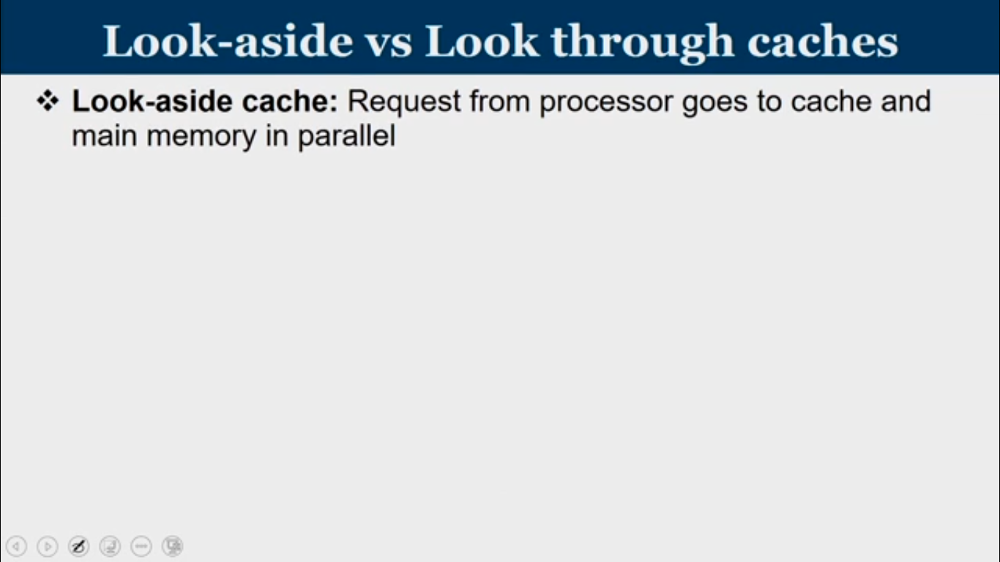
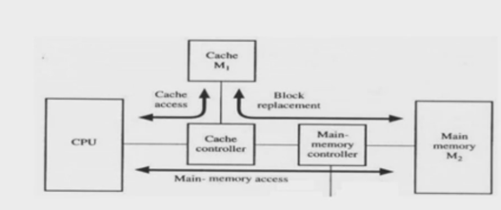

Slide 27
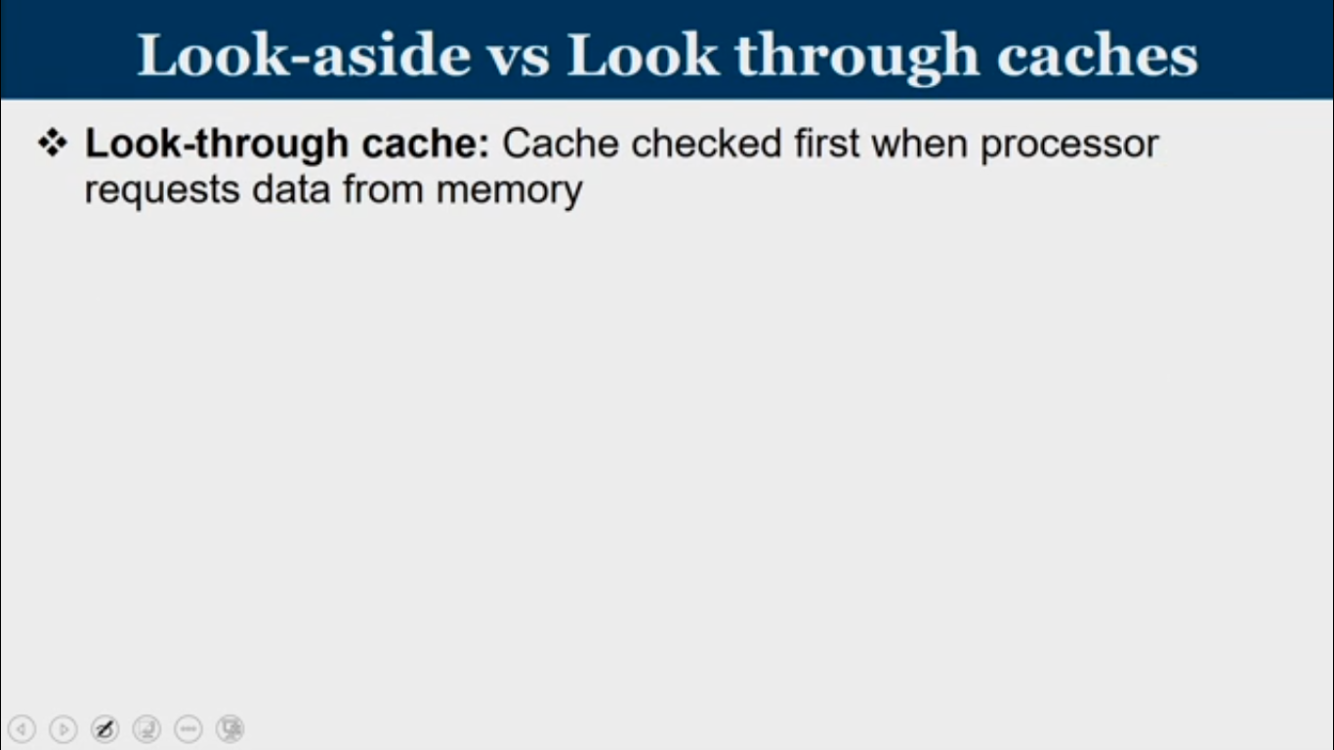
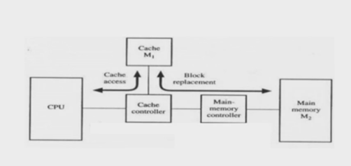

Slide 28
Write-Through: Updates both cache and main memory.
WRITE HIT
Write-Back: Updates only cache; memory is updated later when block is evicted, using dirty bit.
WRITE STRAGEY
Write Allocate: Block is loaded into cache, then written.
WRITE MISS
No Write Allocate: Write goes directly to memory without loading into cache.

Slide 29
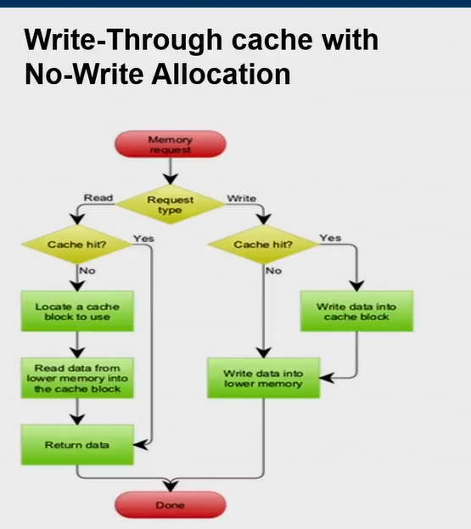

Slide 30
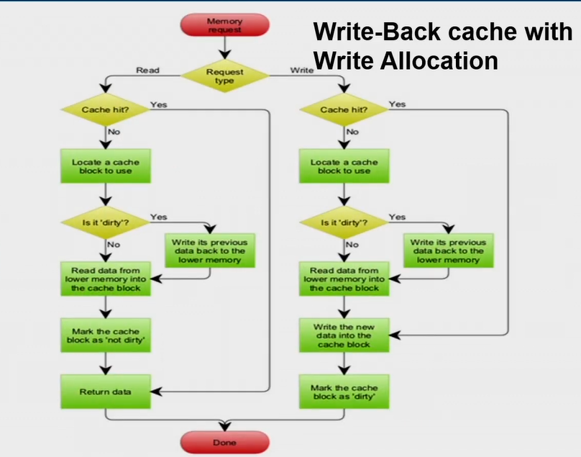

Slide 31

OUR APPROACH:
We plan to start with the most basic mapping technique i.e, direct mapping and gradually extend it to support more advanced configurations, including 2-way and 4-way set-associative caches.

Slide 32
THANK YOU

